Slide 1
FIRMWARE Extraction USING JTAG and UART
Prudhvi Raj Dasari
Computer Science and Information system
Hosam, Alamleh
9/18/2025

Slide 2
Introduction
Firmware is the core software running on the embedded devices like IoT devices and routers.
Controls the boot process, hardware drivers and network services.
Firmware stored in the non-volatile memory and updated infrequently, easily target for the attackers.
Vulnerabilities allow attackers
Reverse engineering firmware to find the exploits
Gain unauthorised access or launch malware
Large scale attacks like Mirai botnet
Safely extract and analyse firmware by JTAG/UART and to identify fix the security before the exploitation.

Slide 3
Problem Statement
Firmware are rarely updated; many devices are outdated code with known vulnerabilities.
Manufactures often:
Leave hardcode credentials in firmware
Provide infrequent update of security patches
Disable or hide debug interface of JTAG/UART, make analyze hard.
Vulnerabilities remains undiscovered and exploited for
Unauthorized devices access
Data theft and network compromises
Large scale botnet attacks.
A systematic approach to extract and analyse firmware to detect and mitigate these risk early.

Slide 4
Objective
Identify and verify the JTAG/UART pins on device by using multimeter.
Extracting the firmware using the hardware tools (Z3x shell, Easy JTAG Plus, Easy JTAG Tool) and save it into the binary file.
Configure and stabilize the hardware interface to enable reliable communication during firmware dumping.
Validate the extracted firmware by checking the dump size and generating the checksum to confirm the integrity.
Come up with the security recommendations and discovered weaknesses, improve the router firmware security.
Perform the vulnerability analysis on extracted firmware to find the hardcode credentials and insecure file system

Slide 5
Firmware Security Landscape
Research says that firmware is a critical attack surface across router, IoT devices, and embedded systems.
Studies shows that
Many devices are outdated libraries and weak update mechanisms
Hardcoded credentials
Debug ports are left exposed, attackers can easily extract the sensitive data
Mirai botnet demonstrated the security incidents in the real-world impact of the insecure firmware on millions devices.

Slide 6
Firmware Extraction Techniques
Software based acquisition:
Download vendor firmware images or intercepting OTA updates
Hardware based acquisition
JTAG and UART interfaces directly read flash memory
Chip of techniques for physical desoldering , when the interfaces are locked.
Recommended approach is no destructive hardware extraction, then fallback to chip off if needed.

Slide 7
Tools
Hardware Tools:
Easy JTAG Plus and Easy JTAG tool are used to connect the device of JTAG interface and read the flash memory.
Multimeter is used to verify the JTAG pins via continuity test.
Bus Pirate is optional, In case JTAG fails, supports the SPI base flash reading for the back up.
Software Tools:
Linux: Environment used for dumping operation
dd/ cat commands: copied flash memory into a binary file
Checksum Utility verified the integrity of the dumped images.

Slide 8
Research Studies
Most of the studies focus on the individual devices rather than the general methodology.
Lack of open-source frameworks for scalable firmware auditing
High false positive rate in automated scanners, need for manual verification.
Need educational resources to guide hands on researchers through JTAG and UART based extraction safely.

Slide 9
Methodology Overview
To extract and analyze firmware using the JTAG and UART interface on the embedded device.
Hardware setup, pin Identification, software configuration, memory dump and validation.
Reproducible methodology that can be replaced on similar devices.
Pinout discovery, JTAG configuration, firmware dumping, checksum validation and basic vulnerability analysis.
A clean binary firmware image for analysis, with document process for future researchers.

Slide 10
Hardware Setup
Target device is Linksys WRT54G2 v1.5 router(2MB flash memory)
Reason for selecting the Linksys router is widely available, simple architecture and visible of JTAG test pads.
Equipment Used
Easy JTAG Tool and Easy JTAG plus
Multi meter to find the JTAG pins
Jumper wire and soldering tools for stable connection
Bus pirate V3
A reliable physical interface to read memory

Slide 11
Tools and Interface
Easy JTAG tool is connected to JTAG header, used to initialize CPU and read the flash memory.
Multimeter is used to find the GND pin and then traced TDI, TDO, TCK, TMS, SRST pins
Bus pirate is a backup to configured the 3.3 V SPI mode if the JTAG fails.
Linux Environment is used for dumping flash memory by command(dd/cat) and checksum verification.
Supporting equipment's like JTAG connectors to avoid the signal loss during the extraction

Slide 12
Pinout Verification
Continuity test to identify the ground pin by probing PCB and header points.
Mapped JTAG pins to TDI, TDO, TCK, TMS, SRST
TRST Pin not detected in the Broadcom/Atheros, Ignored. Using SRST mode instead.
Validated pin mapping ensured successful CPU handshake during the JTAG initialization.

Slide 13

Software Configuration
Easy JTAG Setup: Select the JTAG mode, set the speed below 1000 kHz for stability.
Initialization: chosen SRST reset option to keep CPU halted for memory access.
CPU ID detection once the successful handshake logs confirmed device connection.
Saved initialization and detection logs for reproducibility.
Linux terminal ready for firmware dumping and verification commands

Slide 14
Firmware Dump & Validation
Dump Parameters
Start Address: 0x0000000
Length: 0x00200000 (2MB flash size)
Dump process: Read target flash to binary file Via JTAG interface.
Checksum Generation:
MD5/SHA256 checksum created to confirm dump integrity.
Backup: Dump saved in multiple locations for data safety.
If JTAG fails, bus pirate and flashrom utility used to comple the extraction.

Slide 15

Diagrams

Slide 16
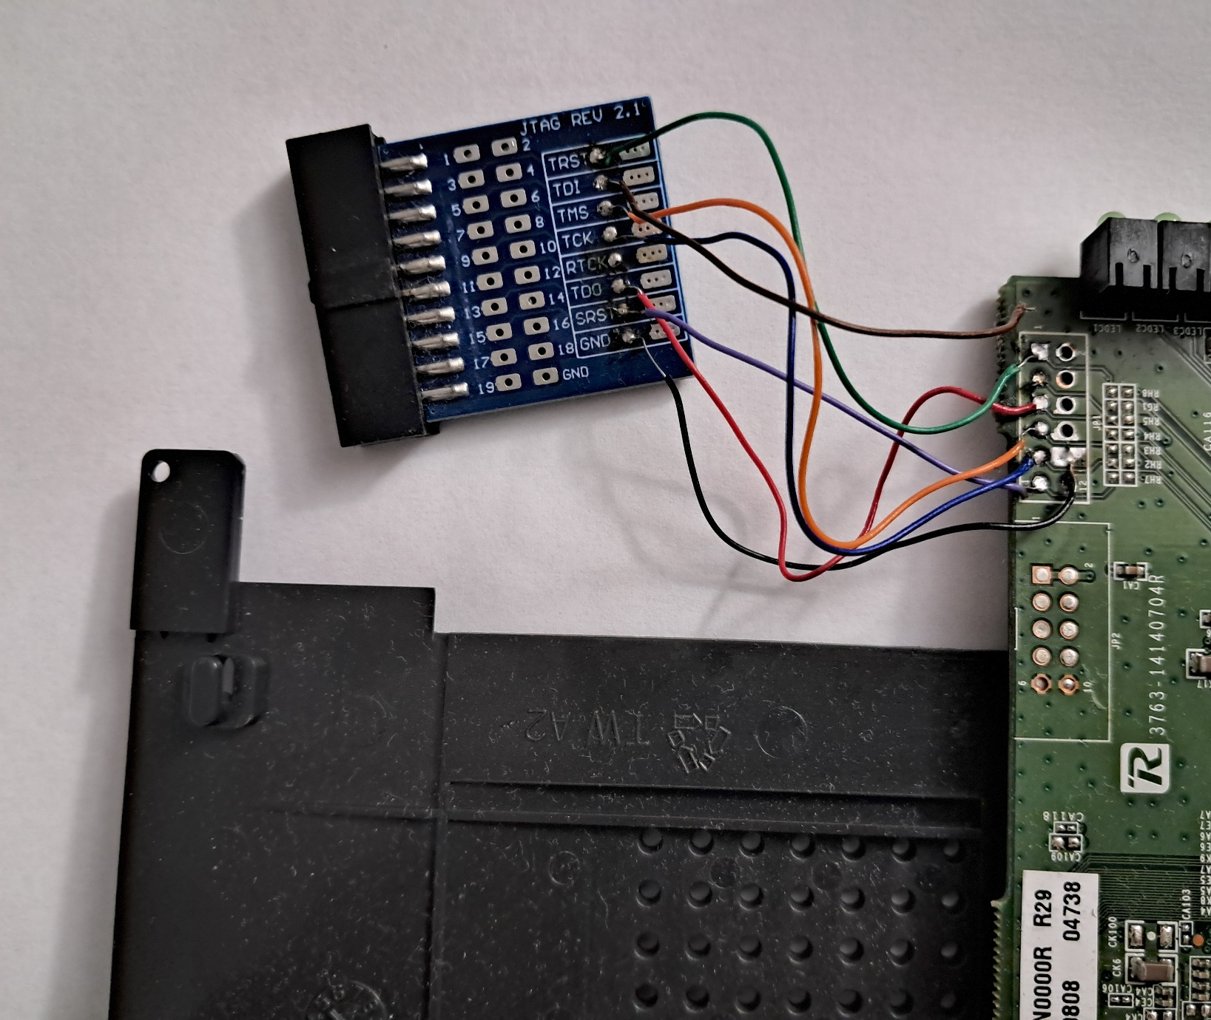
Diagram

Slide 17
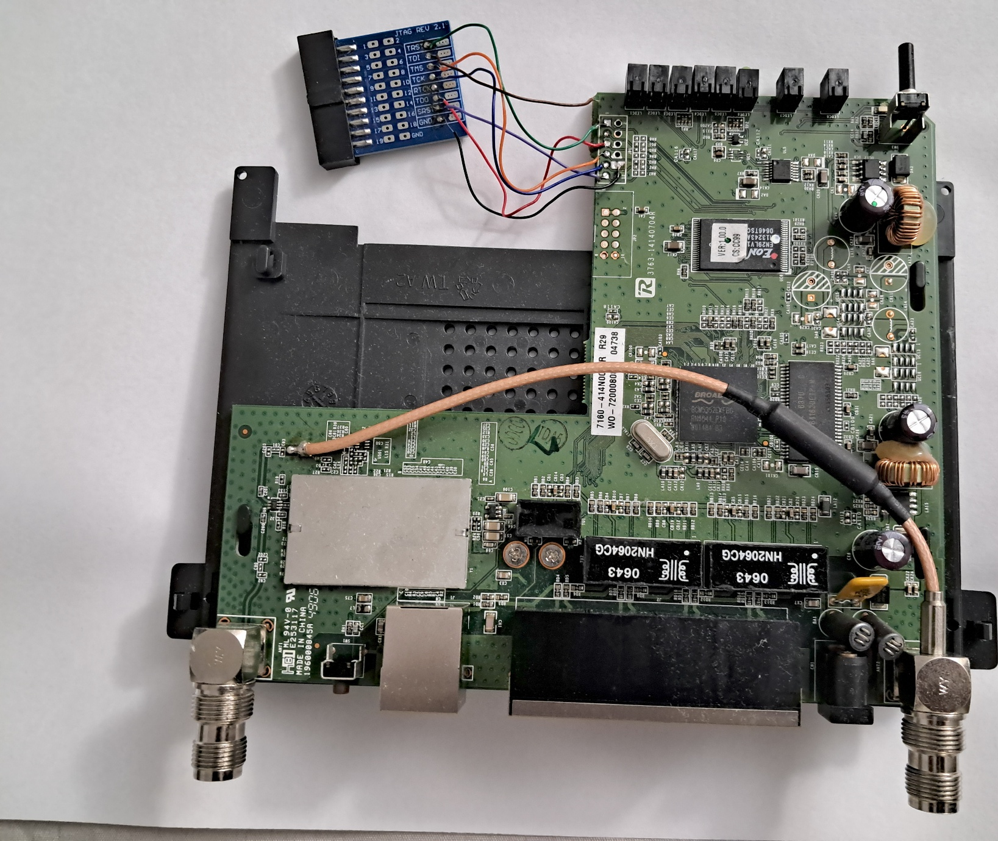
Diagram

Slide 18
JTAG Pin Descriptions
TDI(Test Data In)
This is the input pin where data is shifted into the JTAG chain
When performing boundary scan or programming, TDI carries the data you want to send to the device internal register memory.
TDO(Test Data out)
This is the output pin where data is shifted out of the device.
After sending instruction Via TDI, TDO allows you to read back status, register content or memory data.
TCK(Test Clock)
Provide the clock signal for JTAG communication

Slide 19
JTAG Pin Descriptions
Synchronizes data movement on TDI and TDO.
Lower clock speed (< 1 MHz) are usually required for reliable communication on low-end routers and embedded devices.
TMS(Test Mode Select)
Controls the state of the JTAG
Used to switch between mode(reset, shift, capture, update)
SRST(System Reset)
Also called nSRST(active-low).\
Reset the target device CPU while keeping the JTAG interface active.
Useful when you want to halt the CPU and get stable memory access before dumping firmware.

Slide 20
Firmware Unpacking
Firmware image was inspected using the Linux for patterns and text extraction.
Verified presence of configuration fiels, scripts and network service.
Reverse Engineering: Review on the extracted files
/etc/passwd for default username and password
/etc/init.d/ scripts to identify for active services
SSL/TLS libraries ans version number

Slide 21
Vulnerability Identification
Hardcoded Credentials:
Found default admin accounts.
Insecure Services
Telnet or FTP scripts enabled by default
Outdated component
SSL library are potentially outdated
Weak update Mechanism
No secure OTA process detected

Slide 22
Conclusion
Firmware Extraction Achieved:
Successfully identified and verified JTAG/UART pins using continuity tests.
Stable connection
Configured the Easy JTAG tool with SRST initialization(TRST Ignored).
Partial Progress:
Firmware dump was completed; Extraction is planned as the next phase.
Methodology Documented
Pinout verification done, JTAG configuration, preparation for dumping was successfully recorded

Slide 23
Q & A

